Slide 1

Appartment hunting in London
Coursera | Applied Data Science Capstone
by Martin Kovarik

Slide 2
Introduction
Looking for an appartment to rent in such a busy city like London can be quite time consuming activity.
We can help our clients to save time by providing them additional information beside what they find on the real estate websites.

Slide 3
Introduction - scope
For the purpose of this exercise we chose a family, looking for a two-bedroom apartment in London.

Slide 4
Data
One of the highest value of Data Science is the ability to combine several data sources and produce an easily digestable and understandable output.
In our case we gathered the data from geo location data from Wikipage, rental rates in London from public website and information about typical venues in given locations from Foursquare.

Slide 5
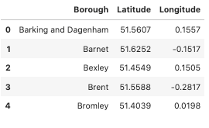
Data
Wikipedia data

Slide 6
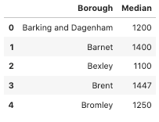
Data
Rental rates

Slide 7
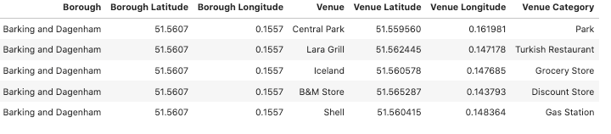
Data
Foursquare data

Slide 8
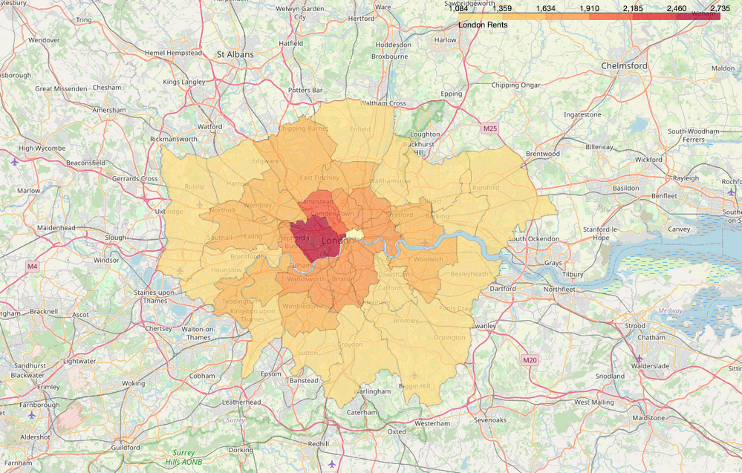
Insights
Visualization of monthly rental rates throughout London

Slide 9
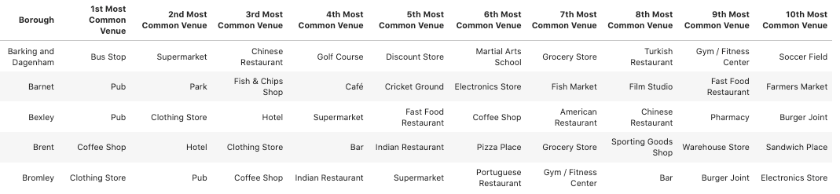
Insights
Typical venues for each London’s borough

Slide 10
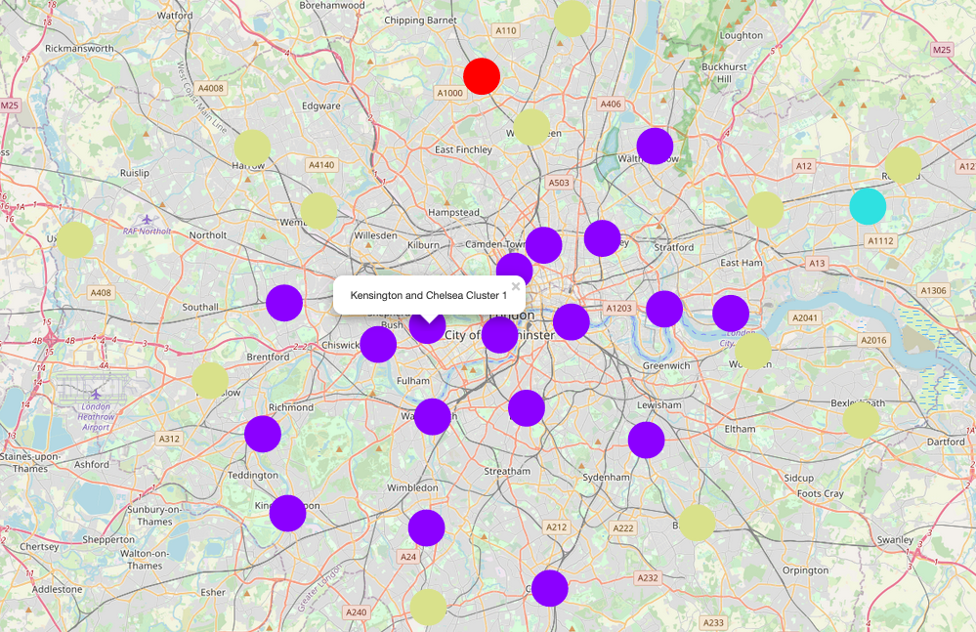
Insights
Borough clustering

Slide 11
Value provided
Family looking for apartment can use the insights provided in this project to:
limit their search with certain criteria like rental rates or borough characteristic
evaluate the rental opportunity with additional tools in form of list of most common venues for given borough

Slide 12
Conclusion
The biggest limit of this project is simply the limitation in the scope of the information I decided to use and the depth of analysis of my demo users.
In real world scenario, applying a design thinking method and employing additional data resources, would provide even stronger apparatus for client's decisions.

